Slide 1
Section 2. Selecting a Chart Type
Lection 5. Correlation, Distribution
(histograms, boxplot, scatter, heat maps, histograms)

Slide 2
General considerations
Data type
Categorical (bar, column, treemap), continuous (scatterplot, heatmap), time series (line, area chart, heatmap).
The goal/insight
Explaining: the message that wish to convey
Exploring: the question you are asking
Common goals for charts are to show:
Comparison/Ranking— the relative order of items.
Composition/Proportions—make up the whole of an entity.
Correlation/Relationship— how two variables are related to one another.
Distribution— is how items are dispersed.
Creating great data visualizations is a skill that is best learned by doing

Slide 3
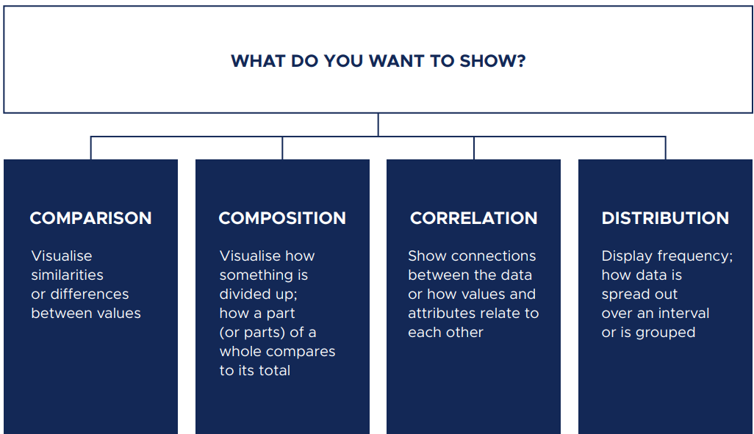

Slide 4
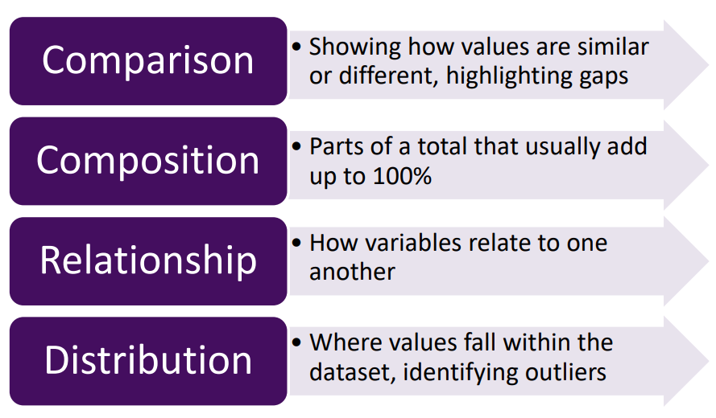

Slide 5
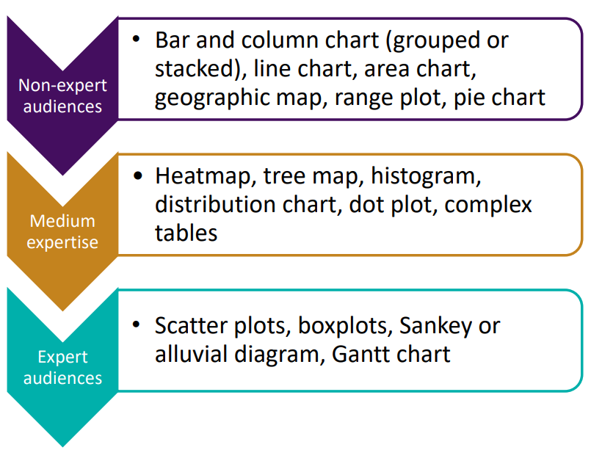
Audience’s level of data/statistics comprehension

Slide 6
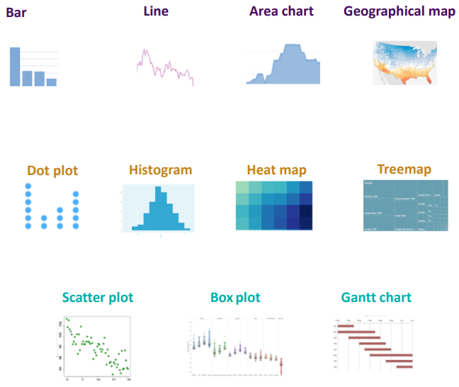
Audience’s level of data/statistics comprehension

Slide 7
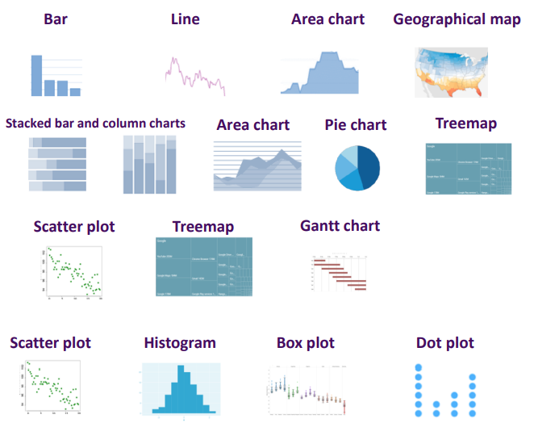

Slide 9
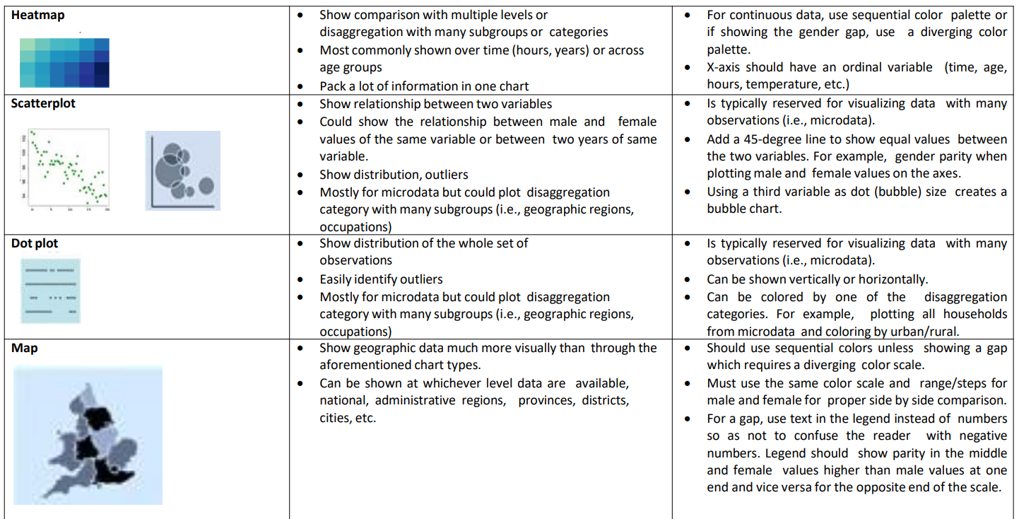

Slide 10
Data | Goal/Insight | Chart type | Example
Categorical | Comparisons, ranking, proportions | Vertical bar, column bar, horizontal bar, bullet charts, Pie charts, Donut charts, group/clustered bars, stacked bar, stacked 100% bar, stacked area, stacked 100% area, and a tree map | Non-numeric data such as types of movies, books, or authors.
Univariate | Distributions, proportions, frequencies | Histogram, density plot, and a boxplot | One numeric variable, such as book price
Multivariate | Relationships, proportions, comparisons | Scatterplot, scatterplot matrix, bubble, parallel coordinates, radar, bullet, and a heat map | Two or more numeric variables, for example, weight, height, and IQ
Time series | Trends, comparisons, cycles | Line chart, sparkline, area, stream graph, as well as bubble, stacked-area, and vertical bar charts. | Years, months, days, hours, minutes, seconds, or date
Geospatial | Locations, comparisons, trends | Choropleth filled-map, bubble map, point map, connection map, and isopleth map | Specific locations marked by the latitude and longitude, regions coded by zip code, city, state, country, or county boundaries
Edge lists or adjacency matrices | Connections, relationships, tie strength, centrality, interactions, similarities | Undirected network diagram (graph) and directed network, Diagram | Who contacts whom or who knows whom in a network
Text | Sentiment, comparisons, frequency | Word cloud, proportional area chart using size bubbles or squares, histogram, and bar chart | Single words or phrases, such as keywords from restaurant reviews

Slide 11
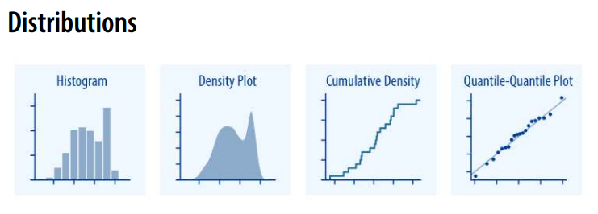
Histograms and density plots provide the most intuitive visualizations of a distribution, but both require arbitrary parameter choices and can be misleading.
Cumulative densities and quantile-quantile (q-q) plots always represent the data faithfully but can be more difficult to interpret

Slide 12
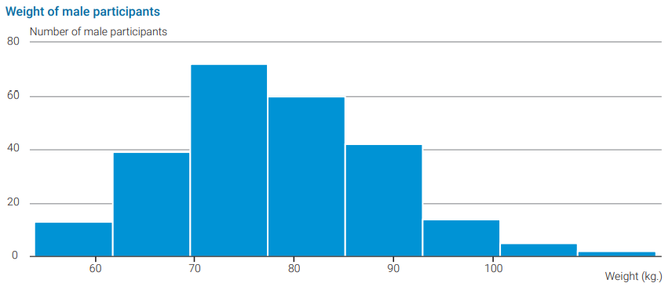
Histogram

Slide 13
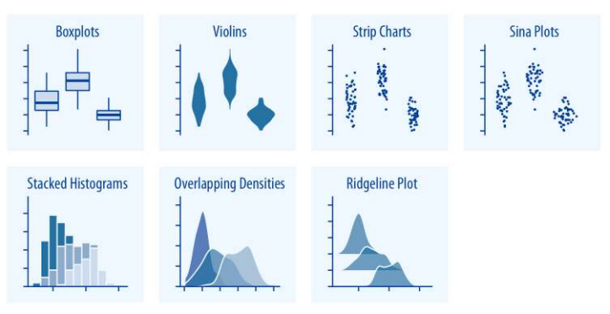
Boxplots, violin plots, strip charts, and sina plots are useful when we want to visualize many distributions at once and/or if we are primarily interested in overall shifts among the distributions.
Stacked histograms and overlapping densities allow a more in-depth comparison of a smaller number of distributions, though stacked histograms can be difficult to interpret and are best avoided. Ridgeline plots can be a useful alternative to violin plots and are often useful when visualizing very large numbers of distributions or changes in distributions over time.

Slide 14
Determining relationships (correlations)
Scatterplots and bubble charts are extremely helpful for this.
This is a great example of the value of data visualization in data analysis. Even descriptive statistics are insufficient to get insight into correlations and outliers.

Slide 15
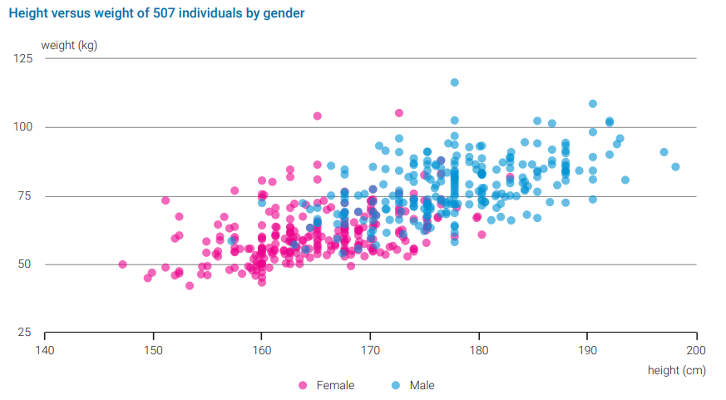
Scatter plot

Slide 16
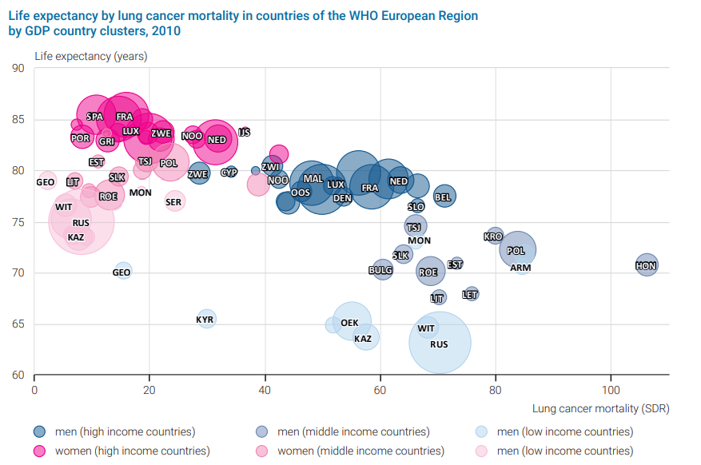
Bubble chart

Slide 17
Heatmap
A heatmap is basically a colour-coded matrix.

Slide 18
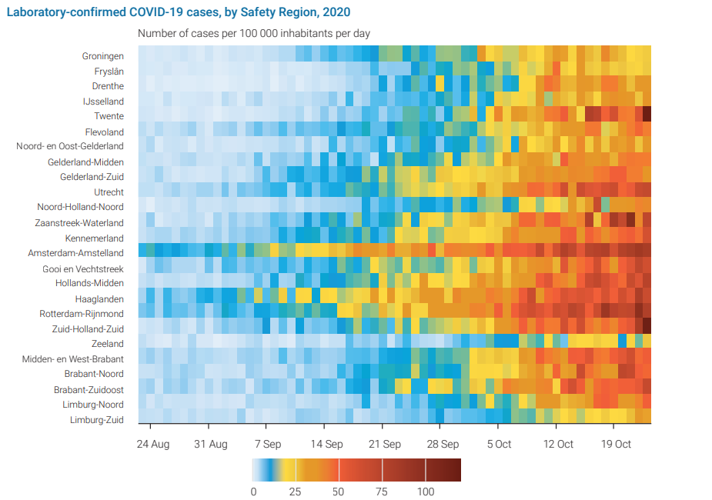
Heatmap

Slide 19
Examining spatial patterns
If a variable has a spatial component, a good way to visualize the distribution over the area (such as a country, region or continent) is a map. This may be the right option for visualizing the variation of mortality between regions in a country, for example. Another example in which a map is a good option is the need to visualize pandemic risk through the degree of connectedness. Epidemiologists use this type of visualization to analyse the way an epidemic is spreading over the country, creating flow maps for this purpose.

Slide 20
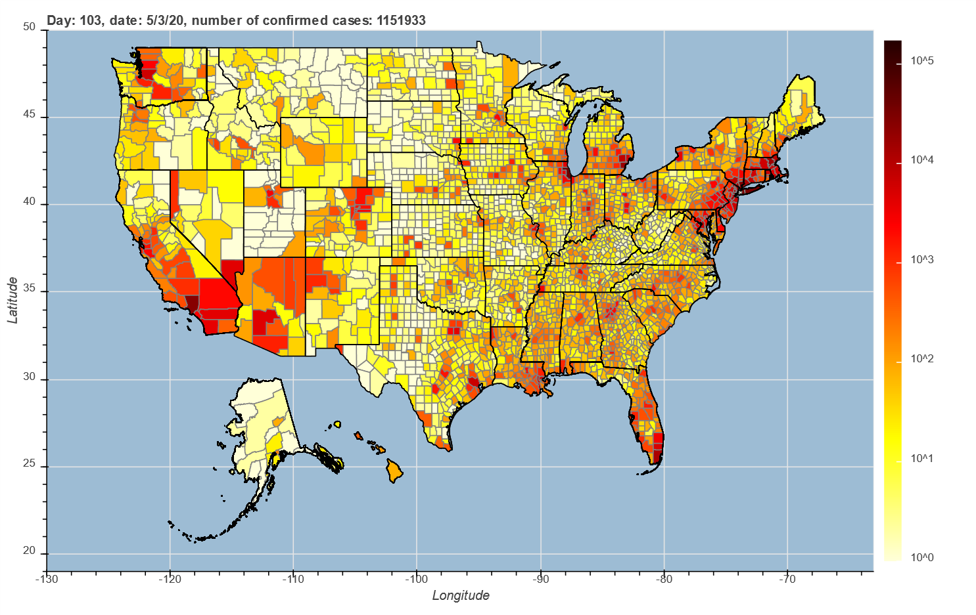
Example of a choropleth map
Number of COVID-19 confirmed cases

